Slide 1
Design Concepts and Principles

Slide 2
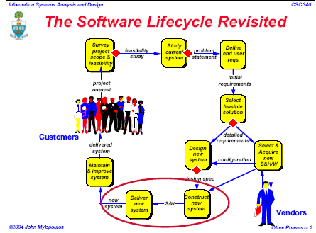

Slide 3
What is Design???
A drawing that shows how something is to be made
The general form or arrangement of something
A mental plan, a purpose.

Slide 4
Definition of Design
The process of conceiving, inventing, or contriving a scheme for turning a specification for a computer program into an operational program;
The activity that links requirements development to construction.
"Design" also refers to the result of the design activity. www.construx.com/survivalguide/glossary.htm

Slide 5
Two major phases:
  Diversification- acquisition of a repertoire of alternatives, the raw material of design
  Convergence and elimination- choice and combination of appropriate elements from this repertoire to meet the design objectives, as stated in the requirements specification and as agreed by the customer by elimination of all but one particular configuration of components.

Slide 6
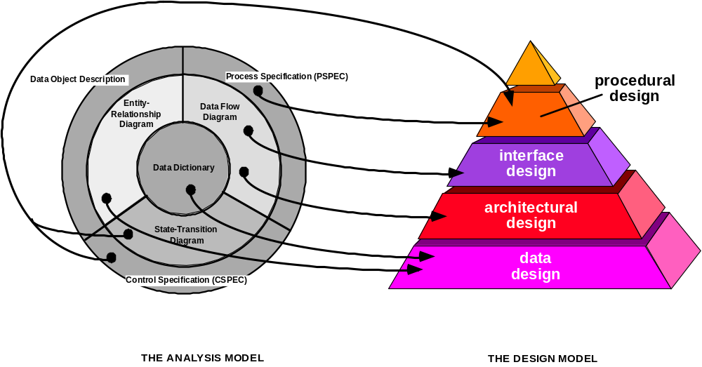
Analysis to Design

Slide 7
Data Design
  Transforms the information domain model created during analysis into the data structures that will be required to implement the software.
  Discovering and completely defining application’s data characteristics and processes.
  A process of gradual refinement from the coarse “What data does your application require?” to the precise data structures and processes that provide it.

Slide 8
Architectural Design
  Defines the relationship between major structural elements of the software, the “design patterns” that can be used to achieve the requirements that have been defined for the system, and the constraints that affect the way in which architectural design patterns can be applied.

Slide 9
Interface design
  Description of how the software communicates within itself,with systems that interoperate with it, and with humans who use it.

Slide 10
Component-level design
  Transforms structural elements of the software architecture into a procedural description of software components.

Slide 11
Characteristics of Design methods
A mechanism for the translation of analysis model into a design representation
A notation for representing functional components and their interfaces
Heuristics for refinement and partitioning
Guidelines for quality assessment

Slide 12
Design Principles
The design should be traceable to the analysis model.
The design should not reinvent the wheel.
The design should “minimize the intellectual distance” [DAV95] between the software and the problem as it exists in the real world.
The design process should not suffer from ‘tunnel vision.’
The design should exhibit uniformity and integration.
The design should be structured to accommodate change.
The design should be structured to degrade gently, even when aberrant data, events, or operating conditions are encountered.
Design is not coding, coding is not design.
The design should be assessed for quality as it is being created, not after the fact.
The design should be reviewed to minimize conceptual (semantic) errors.
From Davis [DAV95]

Slide 13
Fundamental Concepts
abstraction—data, procedure, control
refinement—elaboration of detail for all abstractions
modularity—compartmentalization of data and function
architecture—overall structure of the software
  Structural properties
  Extra-structural properties
  Styles and patterns
procedure—the algorithms that achieve function
hiding—controlled interfaces

Slide 14
Abstraction
Abstraction is the thought process wherein ideas are distanced from objects.
The separation of the logical properties of data or function from its implementation in a computer program http://www.validationstation.com/glossary/glossarya.htm
Abstraction uses a strategy of simplification of detail, wherein formerly concrete details are left ambiguous, vague, or undefined; thus speaking of things in the abstract demands that the listener have an intuitive or common experience with the speaker, if the speaker expects to be understood.

Slide 15
The psychological notion of “abstraction” permits one to concentrate on a problem at some level of generalization without regard to irrelevant low level details
Use of abstraction also permits one to work with concepts and terms that are familiar in the problem environment without having to transform them to an unfamiliar structure.

Slide 16
Types of Abstraction
Procedural abstraction-named sequence of instructions that has a specific and limited function.
Data abstraction-named collection of data that describes a data object.
Control abstraction-implies a program control mechanism without specifying internal details

Slide 17
Procedural Abstraction
open
details of enter
algorithm
implemented with a "knowledge" of the
object that is associated with enter

Slide 18
Data Abstraction
door
manufacturer
model number
type
swing direction
inserts
lights
type
number
weight
opening mechanism
implemented as a data structure

Slide 19
Control Abstraction
Example
  Automatic door making decisions of existence of an object to enter or leave so it should open or close.

Slide 20
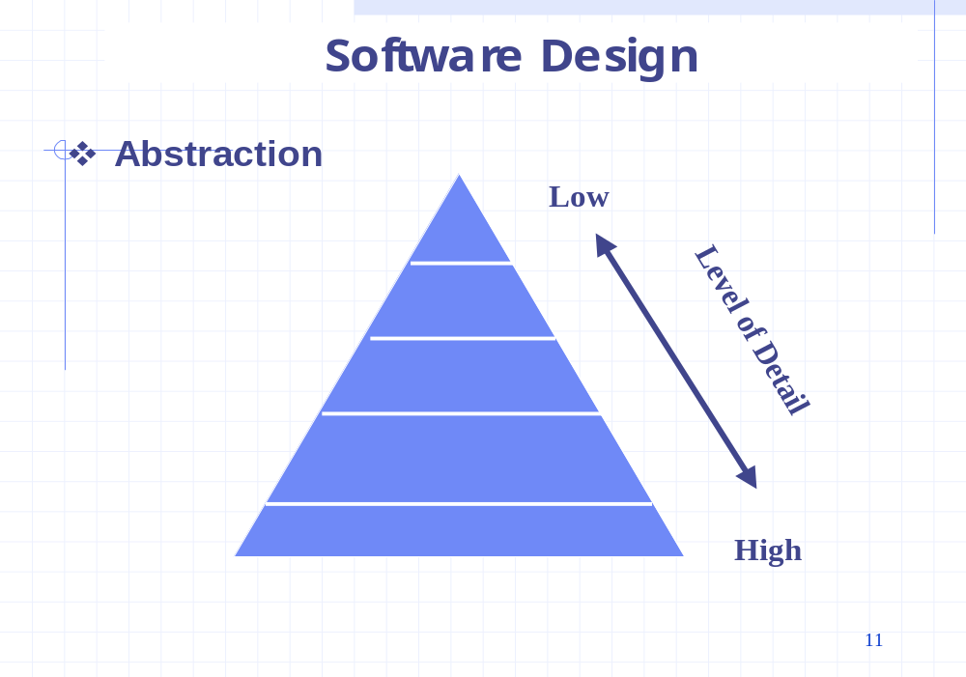

Slide 21
Refinement
Stepwise refinement
  Top-down design strategy
  One or several instructions of the given program are decomposed into more detailed instructions (elaboration).

Slide 22
Stepwise Refinement
open
walk to door;
reach for knob;
open door;
repeat until door opens
turn knob clockwise;
walk through;
if knob doesn't turn, then
close door.
take key out;
find correct key;
insert in lock;
endif
pull/push door
move out of way;
end repeat

Slide 23
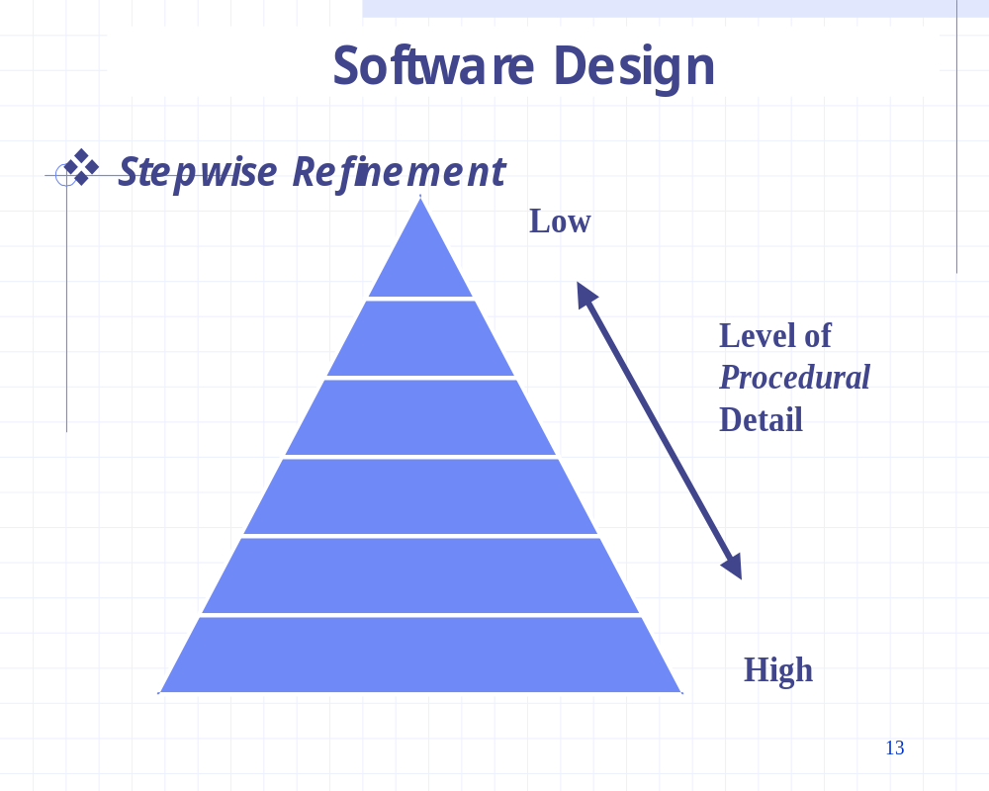

Slide 24
Abstraction and Refinement
Complementary concepts

Slide 25
Modularity
Software
Modules
Requirements
Divided into
Integrated to satisfy

Slide 26
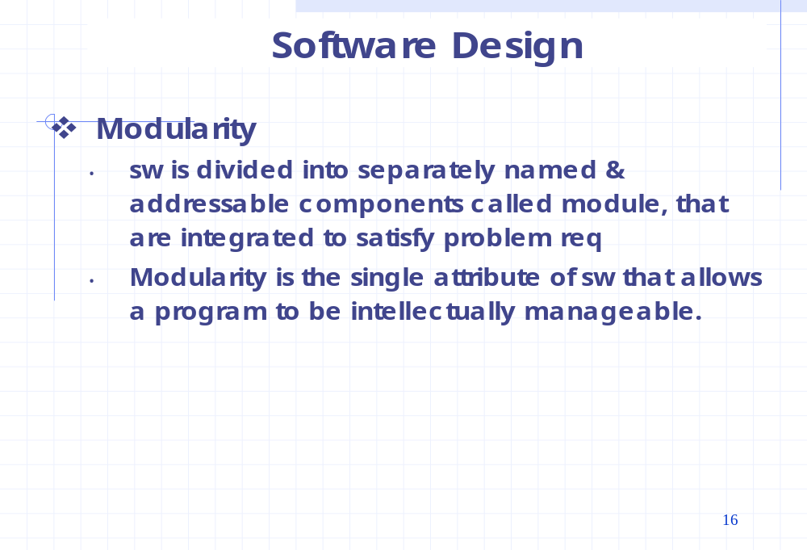

Slide 27
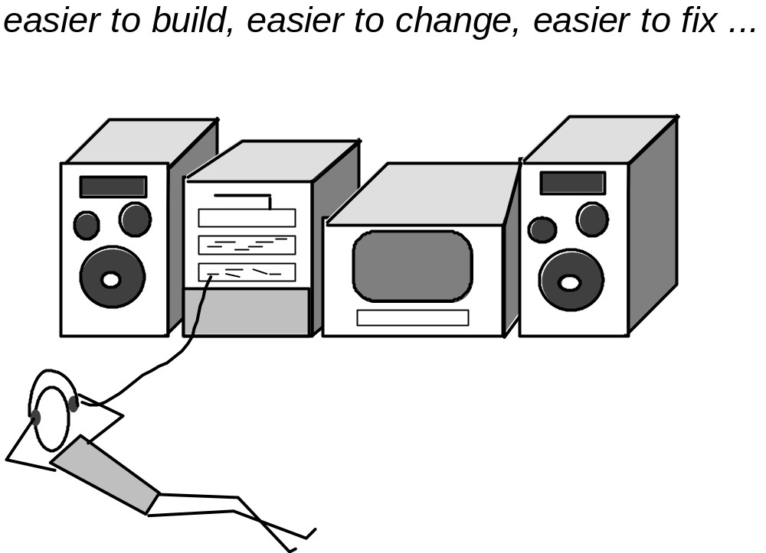
Modular Design

Slide 28
C(p1)>C(p2)
E(p1)>E(p2)
C(p1+p2)>C(p1)+C(p2)
E(p1+p2)>E(p1)+E(p2)

Slide 29
Modularity: Trade-offs
What is the "right" number of modules
for a specific software design?
module development cost
cost of
software
module
integration
cost
optimal number
number of modules
of modules

Slide 30
Evaluate a design method w.r.t. Ability to define an Effective Modular System
Modular decomposability
Modular composability
Modular understandability
Modular continuity
Modular protection

Slide 31
System
Definitions:
  A system is a collection of connected units that are organized to accomplish a specific purpose. A system can be described by one or more models, possibly from different viewpoints UML 1.3
  A system is a collection of components organized to accomplish a specific function or set of functions. IEEE Std. 610.12-1990

Slide 32
Architecture
“The overall structure of the software and the ways in which that structure provides conceptual integrity for a system.” [SHA95a]
Software architecture is the structure of a program's or systems' components, the interrelationships among the components, and a set of rules that govern the interaction and evolution of the program/system.

Slide 33
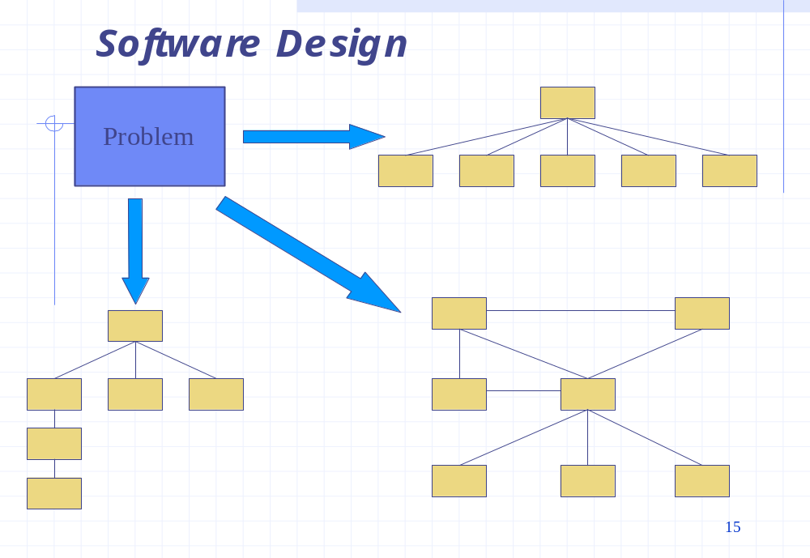

Slide 34
“The software architecture of a program or computing system is the structure or structures of the system, which comprise
▪ software components
▪ the externally visible properties of those components,
▪ and the relationships among them.”

Slide 35
Control Hierarchy
Represents the organization of program components and implies a hierarchy of control.
Depth-provide an indication of the number of levels of control
Width-overall span of control
Fan-out-a measure of number of modules that are directly controlled by another module
Fan-in-a measure of number of modules that directly control a given module

Slide 36
Subordinate
Superordinate

Slide 37
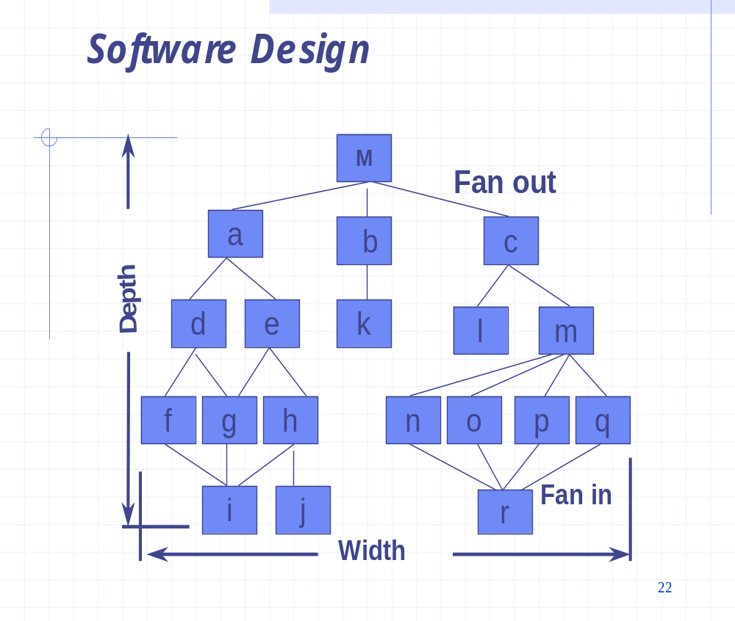

Slide 38
EXECUTIVE
Fan out
Depth
MODULE A
MODULE B
MODULE C
MODULE D
MODULE E
MODULE F
MODULE G
Fan in
Module X
Module Y
Module Q
Module R
Module M
Module N
Module K
Module L
Module S
Module T
Breadth

Slide 39
Structural Partitioning
Horizontal Partitioning
Vertical Partitioning

Slide 40
Horizontal Partitioning
Benefits of Horizontal Partitioning
  Software easier to test
  Software easier to maintain
  Propagation of fewer side effects
  Software that is easier to extend
Drawbacks of Horizontal Partitioning
  More data passed across module interfaces
  Can complicate the overall control of program flow

Slide 41
Vertical Partitioning
Benefits of Vertical Partitioning
  Less likely to be susceptible to side effects when changes are made.
  More manageable

Slide 42
Data Structure
Representation of the logical relationship among individual elements of data.

Slide 43
Information Hiding
module
• algorithm
controlled
interface
• data structure
• details of external interface
• resource allocation policy
clients
"secret"
a specific design decision

Slide 44
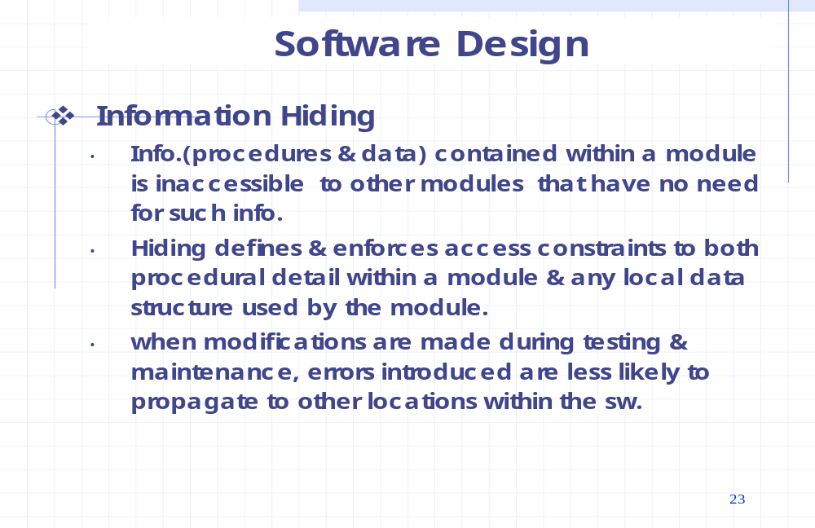

Slide 45
Why Information Hiding?
reduces the likelihood of “side effects”
limits the global impact of local design decisions
emphasizes communication through controlled interfaces
discourages the use of global data
leads to encapsulation—an attribute of high quality design
results in higher quality software

Slide 46
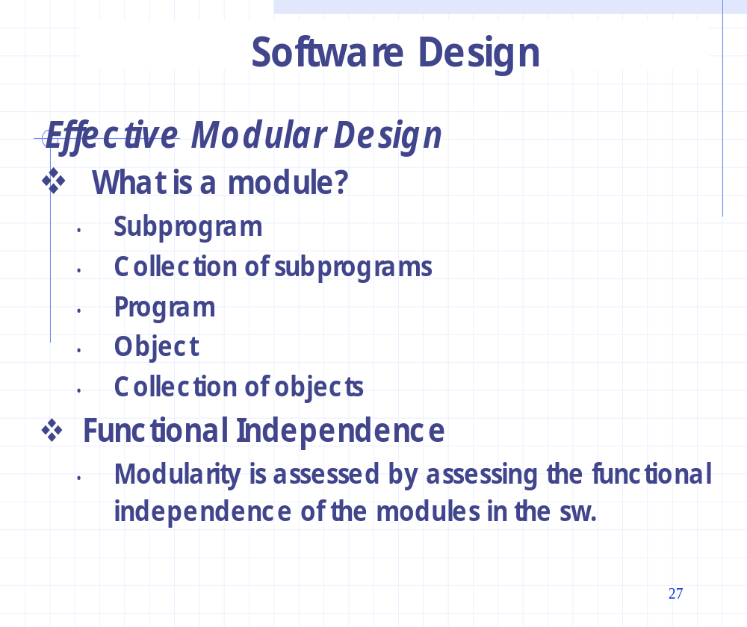

Slide 47
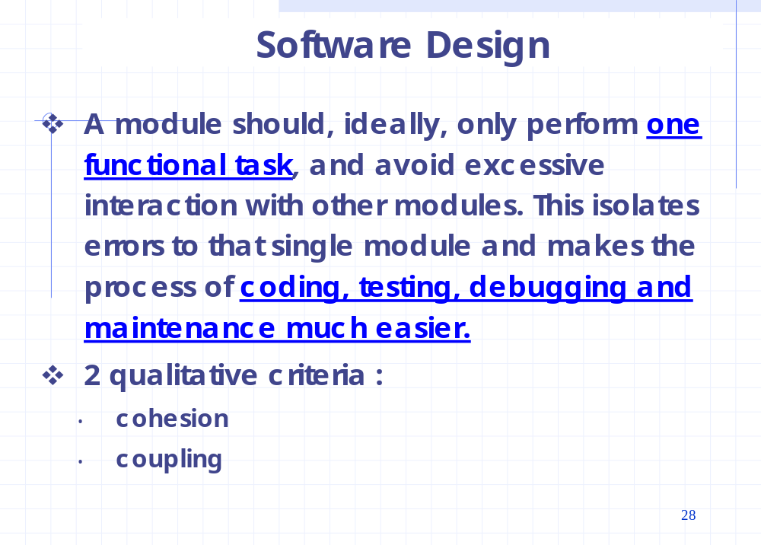

Slide 48
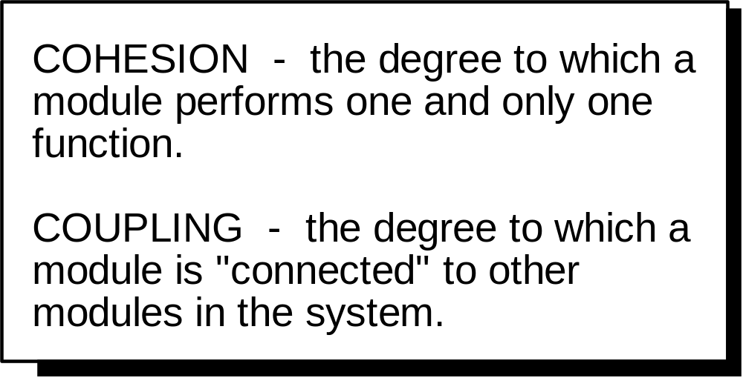
Functional Independence

Slide 49
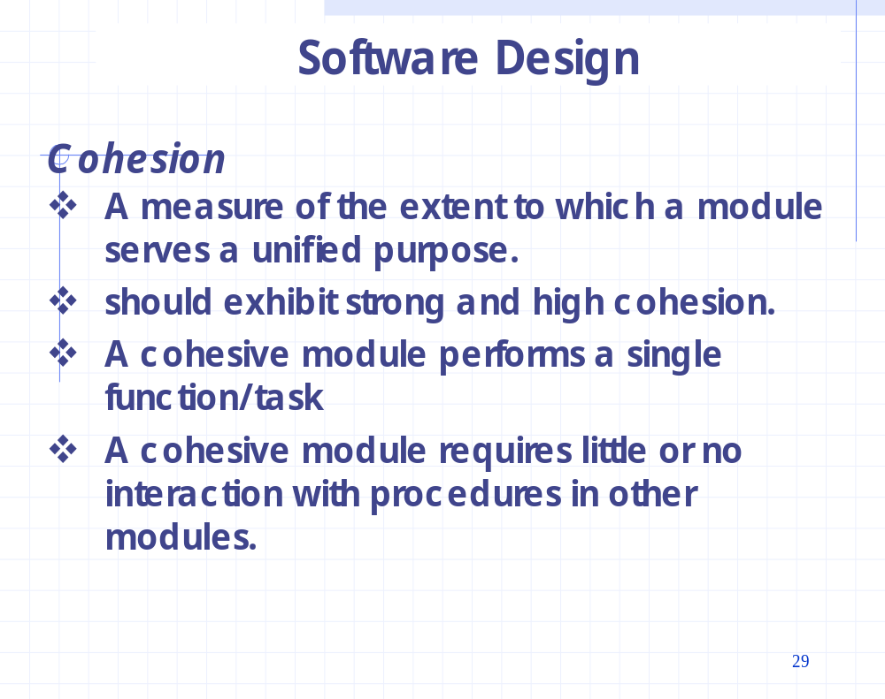

Slide 50
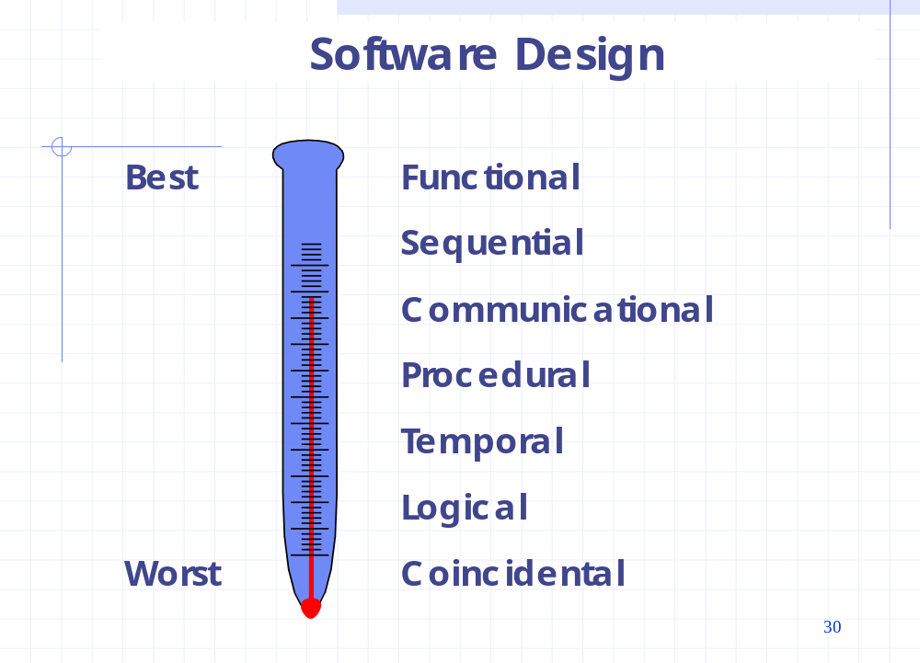

Slide 51
Functional Cohesion
  Contains elements that all contribute to the execution of one and only one problem-related task.
  Example
    Compute cosine of angle
    Verify alphabetic syntax
    Read transaction record
    Determine customer mortgage repayment
    Compute point of impact of missile
    Calculate net employee salary
    Assign seat to airline customer
  Each of these modules has a strong, single-minded purpose.

Slide 52
Sequential Cohesion
  Elements are involved in activities such that output data from one activity serves as input data to the next.
  Example
    Clean car body
    Fill in holes in car
    Sand car body
    Apply primer
  This group of four activities cannot be summed up as a single function
  The output from one activity serves as input to the next

Slide 53
Communicational Cohesion
  Elements contribute to activities that use the same input or output data.
  Example
    Find title of book
    Find price of book
    Find publisher of book
    Find author of book
  They all work on the same input data, the book

Slide 54
Procedural Cohesion
  Elements are involved in different and possibly unrelated activities in which control flows from each activity to the next.
  Example
    Clean utensils from previous meal
    Prepare turkey for roasting
    Make phone call
    Take shower
    Chop vegetables
    Set table
  They are related by order of execution rather than by any single problem-related function.

Slide 55
Temporal Cohesion
  Elements are involved in activities that are related in time.
  Example
    PUT OUT MILK BOTTLES
    PUT OUT CAT
    TURN OFF TV
    BRUSH TEETH
  These activities are unrelated to one another except that they’re carried out at a particular time. They’re all part of an end-of-day routine

Slide 56
Logical Cohesion
  Elements contribute to activities of the same general category in which the activity or activities to be executed are selected from outside the module
  Example
    Go by car
    Go by train
    Go by boat
    Go by plane
  Contains a number of activities of the same general kind.

Slide 57
Coincidental Cohesion
  Elements contribute to activities with no meaningful relationship to one another
  Example
    Fix car
    Bake cake
    Walk dog
    Fill out astronaut-application form
    Have a glass of juice
    Get out of bed
    Go to the movies
  Activities are related neither by flow of data nor by flow of control, nor even part of same category.

Slide 58
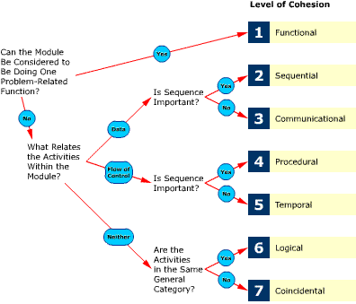

Slide 59
Determining module cohesion
Functional cohesion. A module doing one function can be summed up by a precise verb-object name; for example,
Strong imperative verb
Specific singular direct object
READ
CUSTOMER TRANSACTION RECORD
CALCULATE
NORMAL AUTO INSURANCE PREMIUM
DEDUCT
FEDERAL TAXES

Slide 60
Sequential cohesion. A number of assembly-line functions show sequential cohesion, as in
  VALIDATE TRANSACTION AND [USE IT TO] UPDATE MASTER RECORD
Communicational cohesion. A number of nonsequential functions working on the same data are the clue here; for example,
  CALCULATE AVERAGE AND MAXIMUM EMPLOYEE SALARY

Slide 61
Procedural cohesion. Look for procedural or “flowcharty” names; for example,
  LOOP ROUTINE or SWITCH MODULE
Temporal cohesion. Time-related names are a giveaway; for example,
  START UP, END OF JOB, or BEFORE...

Slide 62
Logical cohesion. The name is an umbrella or general-purpose one; for example,
  INPUT ALL or EDIT MODULE
  and to use the module, a flag is needed.
Coincidental cohesion. The name is silly or meaningless; for example,
  FRUNK-MODULE, PROCESS-ROUTINE, ROUTINE-X9721-p
  and to use the module, a flag is needed.

Slide 63
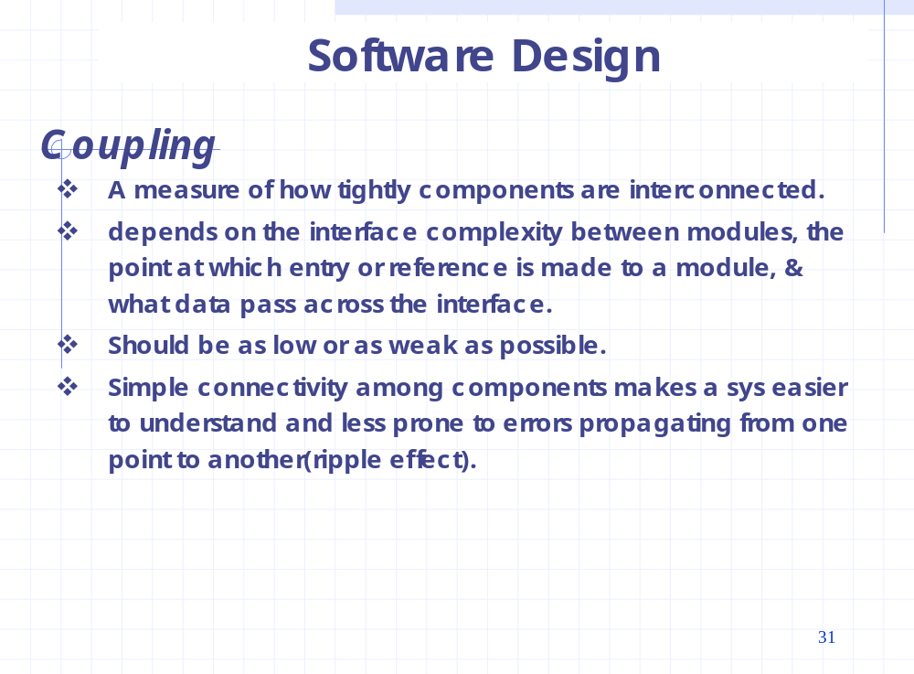

Slide 64
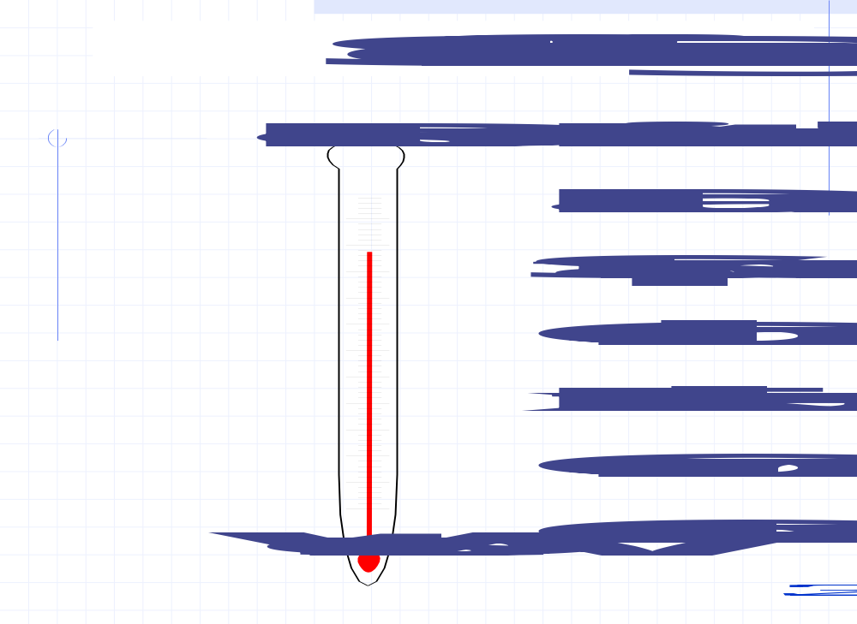

Slide 65
Coupling
A measure of interconnection among modules in a software structure.
Depends upon
  Interface complexity between modules
  Point at which entry or reference is made to a module
  What data pass across the interface

Slide 66
Data coupling
Stamp coupling
Control coupling
External coupling
Common coupling
Content coupling
Compiling coupling
Operating system coupling

